Slide 1
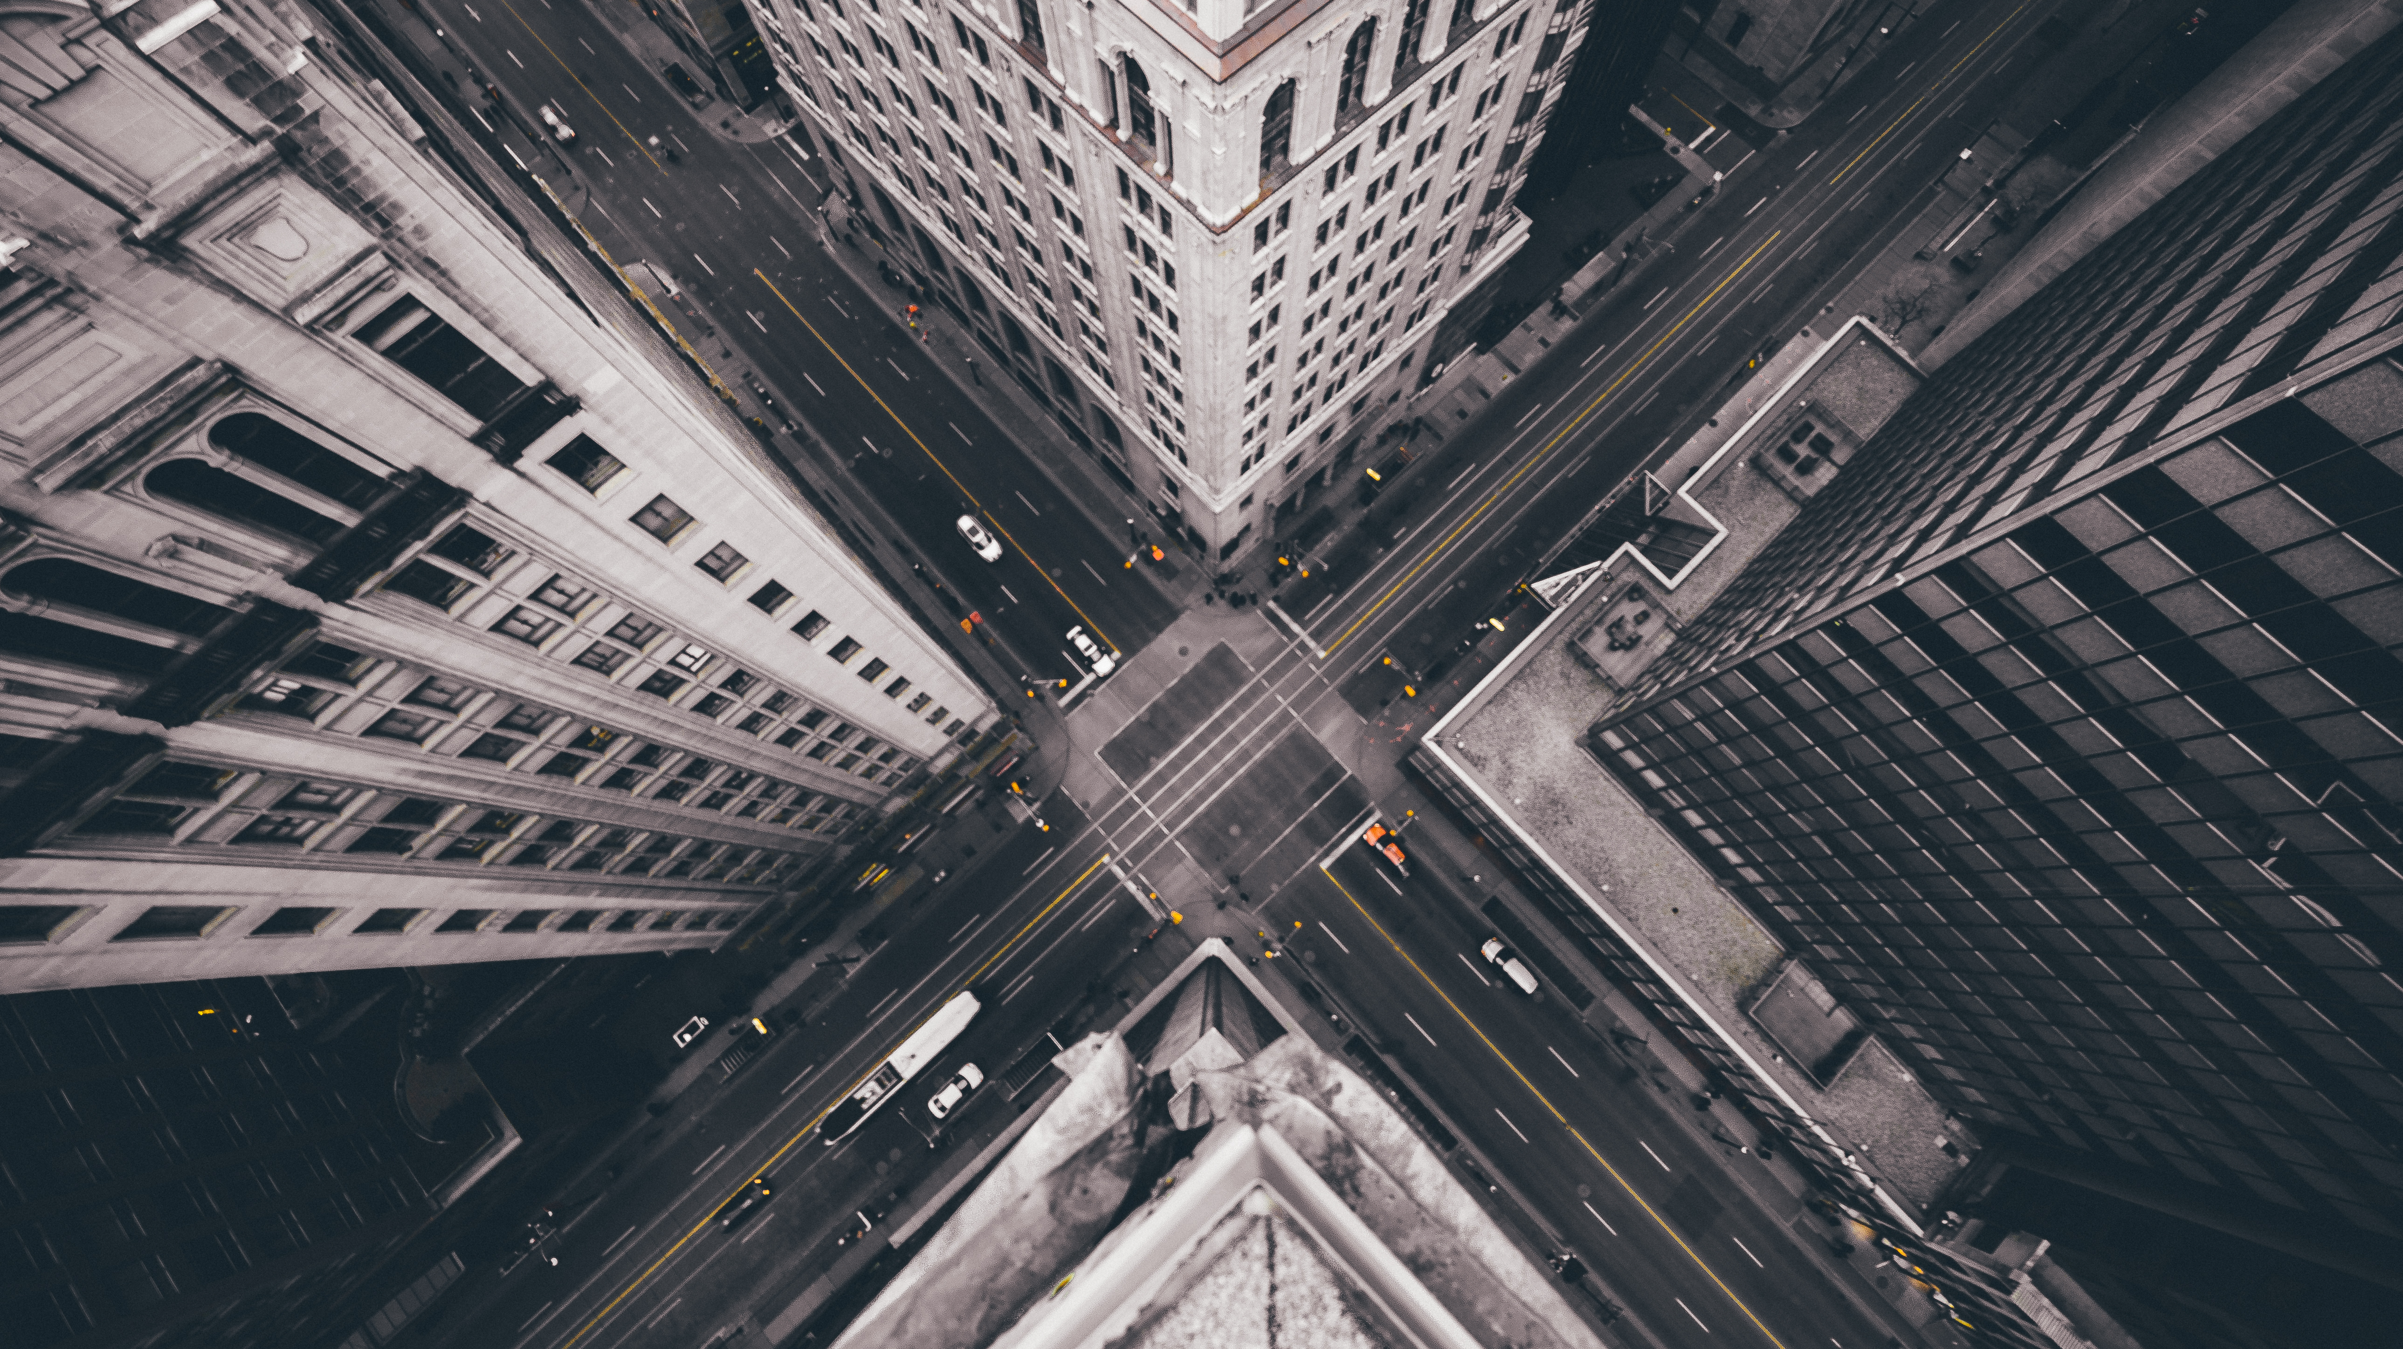
Traffic Violation Detection
Joseph Rosenblum
DSI-US-13 EC Capstone

Slide 2
Contents
Executive Summary
Problem
Methodology
Data
Model
Evaluation
Conclusion + Next Steps

Slide 3
Executive Summary
Context | Many municipalities make material investments into traffic monitoring cameras to reduce the man-hours of traffic police, increase revenues though accurate detection of violations, and save pedestrian lives. Yet, without significant updates to software, it is challenging to unlock the full potential of traffic cameras.
Objective | Utilize object detection software to interpret moving vehicle traffic violations from available camera data.
Methodology | A data format resembling one currently available to The City of New York (of even lower resolution and quality) was used to train an object-detection model. The model was trained to specifically identify vehicles and signals, and the output was used to assess whether vehicles were stopped in a pedestrian crosswalk during a red light.
Findings | This approach is viable. While not robust enough on its own, there is a clear path forward to improving the model’s performance, which would enable it to both become more reliable and to detect additional violations.
Notes:
Objective: The intent of this project was to create a method of detecting traffic violations from available camera data. Data was chosen that matches format to what is currently available to The City of New York, while having lower resolution and quality. This is to show that investments to hardware already made can be enhanced through software to provide this functionality.
Findings: A method has been identified that can identify traffic violations. Currently the project is limited to identifying vehicles that have stopped in the crosswalk at a red light, but there is a clear path forward to add more violations and to improve performance.

Slide 4
Problem
Today’s traffic monitoring cameras are limited by their software | Municipalities today are cash-strapped, with $360B in losses expected between 2020 and 2022 There is a need to do more with less, and automation presents a material opportunity Traffic cameras can save municipalities policing labor costs, increase revenues from ticketed violations, and save lives Some municipalities report red light cameras generating revenues in line with an average business In addition, traffic cameras reduced red-light running fatalities by close to 25% in 14 of the most populated cities in the U.S. Despite the potential value-add of this infrastructure, the cameras can have high installation and operating costs, with an average price tag of ~$100K Municipalities must therefore weigh the cost-benefit analysis of purchasing such hardware The strongest case to be made for red light cameras is an ongoing improvement to the efficacy of the software they run on Today’s camera software operates on sensors and can only detect a limited number of offenses Neural networks, however, can “upgrade” the functionality of cameras by enabling them to detect an expanded range of moving violations
Notes:
Municipalities today are cash-strapped, with $360B in losses expected between 2020 and 2022. During times of shortfall, states have historically chosen to cut spending.
More broadly, efforts to improve budgets to date have focused on cost reduction, primarily through reduction of labor hours through automation. Major technology infrastructure projects have accommodated this push, with trillions in anticipated spending. And yet, the cost-savings from this technology have not been unlocked due to an insufficient parallel investment in software improvements.
In our current system, traffic violations occur constantly and are frequently not enforced. For most, there simply are no police present when they occur. Even police presence does not guarantee enforcement. Subjective decisions must be made: whether or not a violation committed justifies a car stop; whether a justifiable car stop is more important than whatever assignment they are currently on; whether they are prepared to follow up the issuance of a summons by going to court when required.
This leads to uneven enforcement. The public may not always be aware of what factors are considered by police when they make a car stop or issue a summons, and that lack of insight is not a good thing. For one thing, it can lead people to speculate that the worst motives which they themselves can imagine are the ones that actually drive policing decisions.
Even when a car stop is made and a summons is issued, car stops for traffic infractions are not, in general, an effective method of traffic enforcement. The potential cost is too high. No Police Officer, vehicle operator, or bystander should need to take on any additional risk over a minor traffic infraction that has already been committed.
I propose leveraging advanced object recognition techniques into traffic inforcement cameras to broaden their capabilities.
Currently, red-light camera systems and speeding systems exist and are broadly implemented. These systems are expensive to purchase, install, and maintain. These systems are each limited to only red-lights or speeding. Each state and local government has thier own standards to follow for implementation of these devices. In New York State, for example, each city of one million residents or more may hold a vehicle owner liable for fines associated with violations detected by these camera systems, but are only allowed to install them at a maximum of 150 locations. Which means we need to do more with less.
A machine-learning-based approach could be both less expensive and more effective. To demonstrate low cost, this project will use data generated from inexpensive web-cams, typically costing no more than $100. To demonstrate effectiveness, this project will focus on enforcement of vehicles stopped in a crosswalk, which is both dangerous for pedestrians and infrequently enforced.

Slide 5
Methodology
Create a video surveillance environment like one possible for a municipality to achieve and use it to identify at least one type of traffic violation.
1 | Selected dataset closest to real-life scenario based on image resolution and content
2 | Trained the model to identify objects necessary to identify if a violation exists within a still image
3 | Identified objects in a test set of images
4 | Identified frames in which all components of a potential violation are present

Slide 6
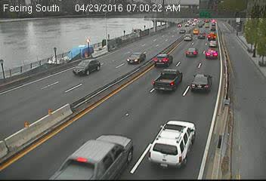
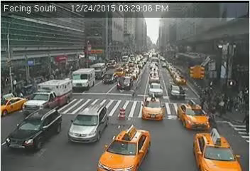

Data
Footage
WebCamTDataset
Sequences of images taken 1s apart from webcam videos
Low resolution of 352 x 240 with grainy compression
Many images of intersections from traffic-control-device height
Data Selection
- Images to train were selected based primarily on whether they include a pedestrian signal
- Image were also restricted to those which show cars approaching and preferably if they are driving through a crosswalk
- Out of 60K frames contained within the dataset, this project was trained on just over 1K
Notes:
Specific parts of the total WebCamT dataset were suitable for this project, rather using the dataset in its entirety. I chose to train on images that would most resemble the test data.
Since the project is focusing on crosswalk violations, I chose to use images taken at intersections with the vehicles facing the camera. Not all intersections included crosswalks or pedestrian signals. Since clear images of pedestrian signals were in shortest supply, they were the limiting factor of how much of the dataset would be useful.
There is a large imbalance between pedestrian signals and vehicles, because every image with a red pedestrian crossing signal could have twenty or more annotated vehicles within. I don't believe this specific imbalance posed a major issue in the training, because this is not a classification problem, and the objects are so different from each other.
More concerning was a positive/ negative imbalance between images that include signals and those that do not. I got best results at detecting if a signal was red when I also included images of the signals when they were not lit up red. Vehicle recognition was not my limiting factor, so I did not add any more images of vehicles than I needed to.
I chose to train on 1025 images, which together contain almost 25000 vehicle annotations and only a few hundred pedestrian signal annotations. These images were taken at the following two locations:
Camera 398 - 3rd Avenue @ East 42nd Street
Camera 181 - 8th Avenue @ West 42nd Street
Annotations of vehicles were included in the dataset. They were created in XML, which I translated into yolo format. During this process, useful images with missing and corrupted annotations were re-annotated.

Slide 7
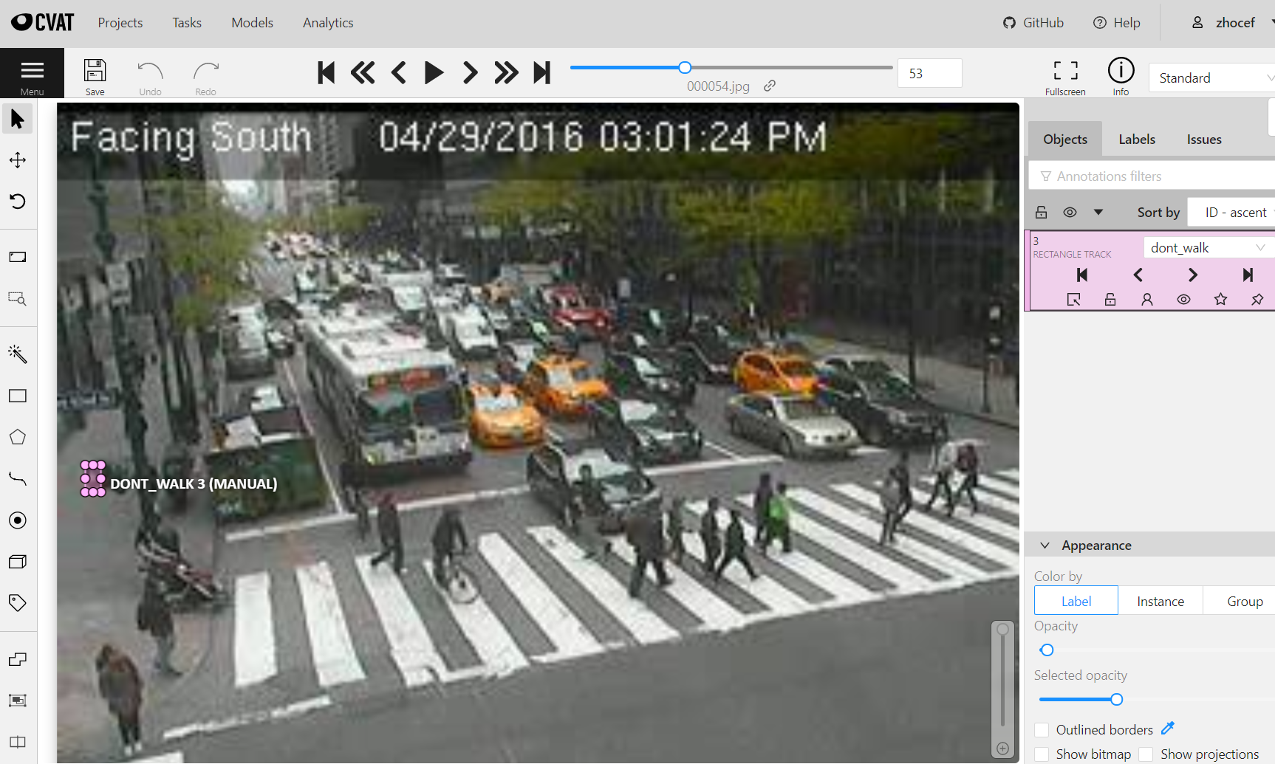
Annotations
Annotations are the labels put on objects to identify them for the model.
Vehicle annotations were converted, signal annotations were created
XML |  | YOLO
Absolute coordinates |  | Relative coordinates
Structured with tags |  | Structured as a table
XML is a ‘tree’ of tagged data and absolute coordinates
Because the original XML annotations are not in the correct form for the model, they were converted to YOLO
YOLO is a list of relative coordinates
Notes:
Annotations were made for crosswalk and pedestrian crossing signals using cvat. All annotations were combined into one single file per image.

Slide 8
YOLOv5x Model
Input
We are using the largest version of the model available, as it is the most accurate and still provides fast enough inference for this project
Training augmentation includes horizontal flips and mosaic
Model will generate bounding boxes for objects identified
Model is evaluated by mean average precision (mAP)
Output
Evaluation
Notes:
YOLOv5 was used for modeling for this project, as it was the best fit for the requirements. The source data chosen is a difficult set to train a neural network on, and this application should provide both fast and accurate results. Given that YOLOv5 provides what I was looking to achieve with this project, it made sense to use.
YOLOv5x is the largest model, providing the highest level of accuracy. It is more than fast enough for our purposes, able to run inference on our data at around 50 fps on available hardware.
Advanced object detection models such as YOLOv5 contain hundreds of layers, and are broken down into sections serving different purposes. The model is trained on bounding boxes to indicate the locations of objects, and returns bounding boxes when used to detect objects.
Mosaic augmentation and horizontal flipping augmentations were implimented in the training set.

Slide 9
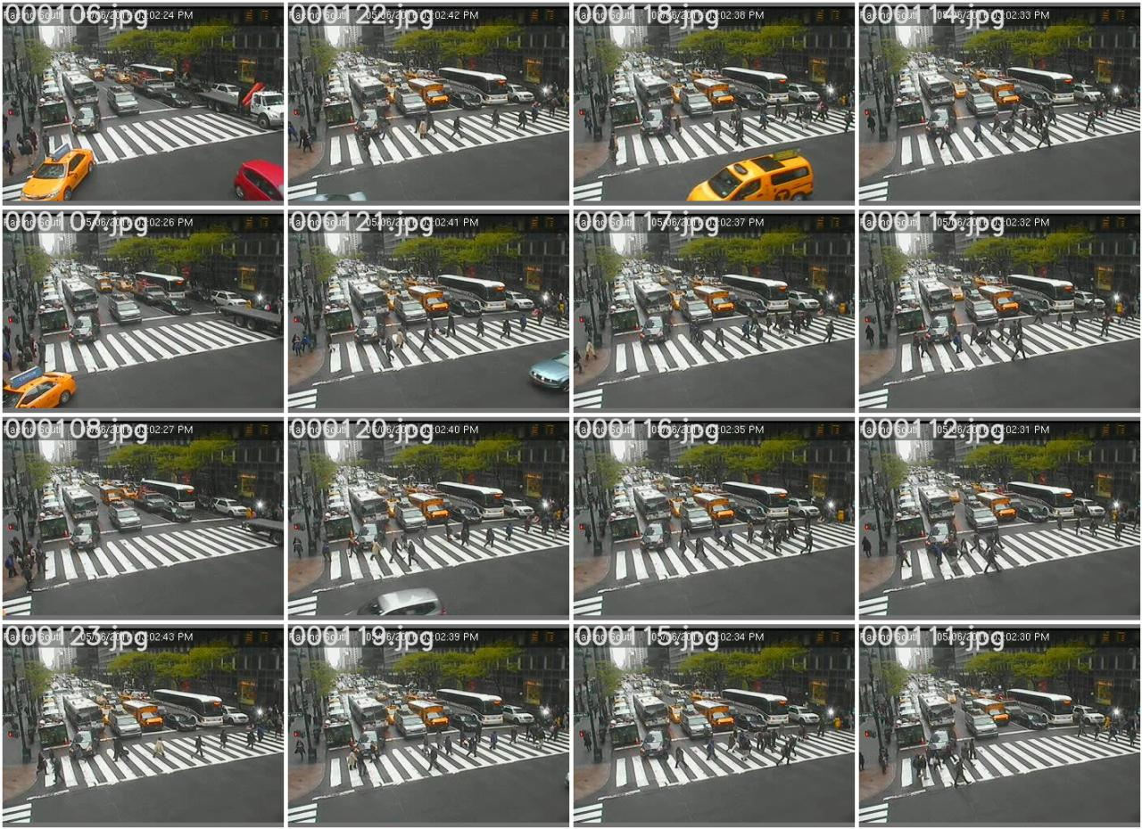
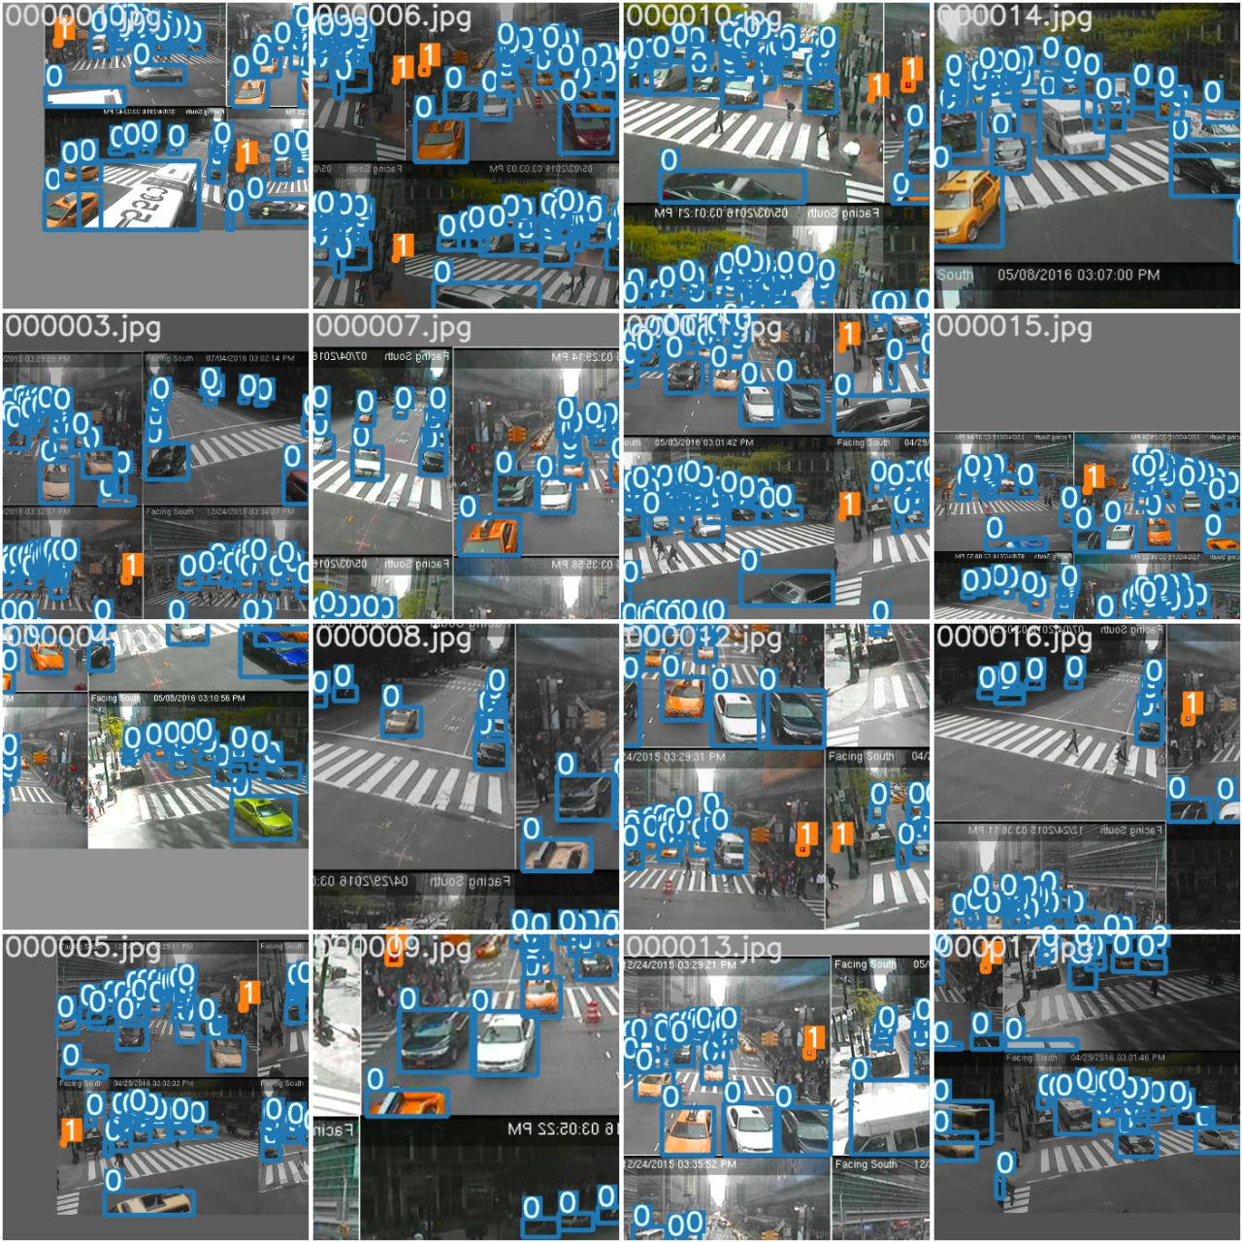
Training
Model
Notes:
Conceptually this is what mosaic training looks like

Slide 10
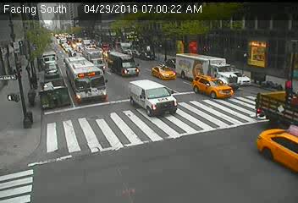
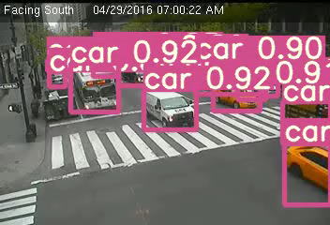
Output
Model
Notes:
This is what our output looks like, visually.

Slide 11
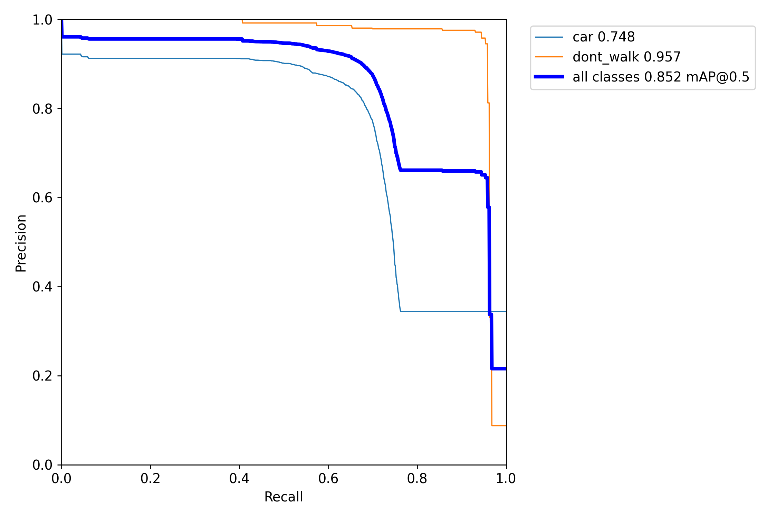
Model Evaluation
A mean average precision 0f .852 is a strong result for this data.
These results should be considered the baseline.
The model has much higher confidence in classifying vehicles at the front of intersections, which are those we are most interested in.
Notes:
This project uses the output from the model to feed a simple algorithm that will detect potential violations. Because of this, the only objects that we will need the model to identify are vehicles and pedestrian crossing signals.
The mean average precision of .852 shows that we are getting good results on our dataset, especially given how poor the image quality is:
Since the intent of the project is to issue a summons, precision is more important than recall. We would rather not give someone deserving a summons a break than to give someone a summons who does not deserve one. Keeping precision above .8, we are getting over .75 recall.
The accuracy metric looks worse than this performs in practice, because the vehicles of interest are those at the front of intersections, which are identified with much more confidence by the model than those in the back. Those in the back are are smaller images occluded by other vehicles.

Slide 12
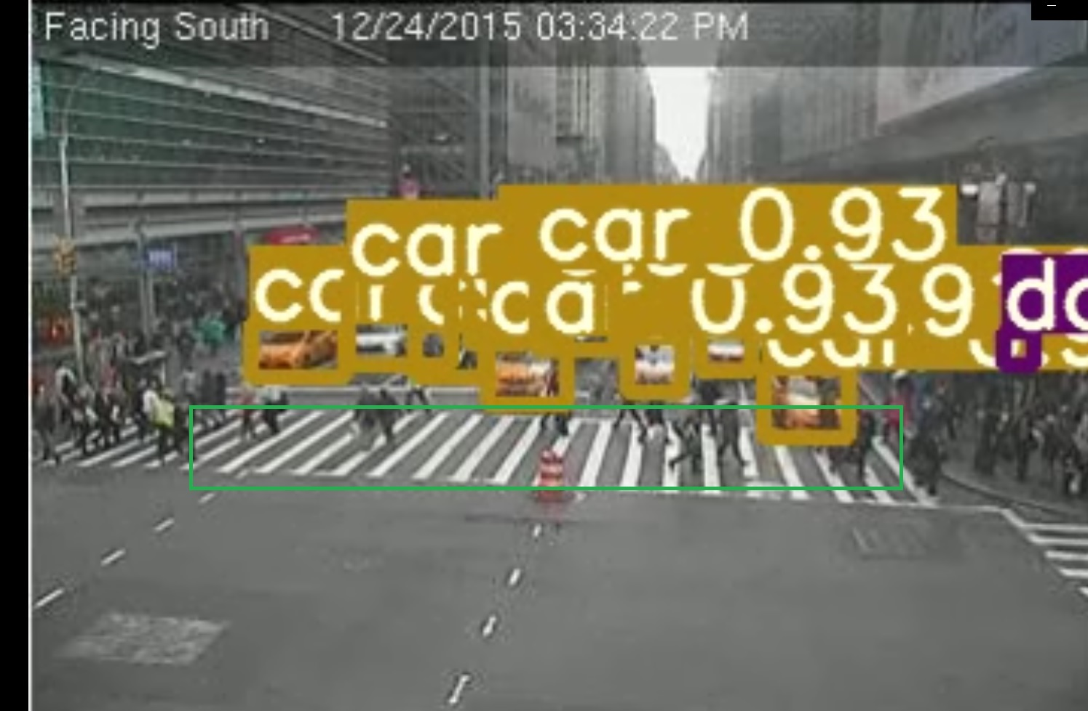
Project Evaluation
Established criteria can be monitored and met:
Vehicle within crosswalk
Don’t walk signal is lit
Conditions existed over x seconds
Notes:
The project have some success at evaluating images to see if they fit the criteria established to determine if a vehicle is stopped in the crosswalk.
After objects are detected, cars are tested to see if their bounding boxes extend below the 'top' of the crosswalk and if the pedestrian crossing signal is activated. If so, it's checked to see how long these conditions for. If they have existed, uninterrupted, for over the specified period of time, the frame is noted as possibly containing the violation we are looking for.

Slide 13
Conclusion
This goal of this project was to create a system that is capable of autonomously identifying traffic violations. This system, in its current state, does come very close, in that it narrows down frames of interest.
This establishes that there is much more possibility from this method, but it does not quite reach our goal of finding these occurrences completely without human validation.
I will continue to work on this project and already have some next steps I am excited to work on.

Slide 14
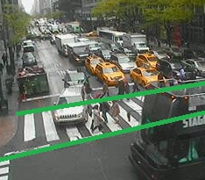
Next Steps
Represent crosswalks as linear equation to account for crosswalks not being straight lines
Use intersection score to judge how deep into the crosswalk a vehicle is rather than a binary determination
Adding a method to tracking objects, rather than trying to determine action from a single image.
Detect more objects, such as busses, bikes & pedestrians
=15
=85

Slide 15
Even Further Next Steps
Detect the crosswalk or even street itself; use perspective to deepen understanding of what is happening
There needs to be a plate reader incorporated to be able to issue a ticket. Much higher-resolution images would be needed to achieve this, which could be:
another layer of object detection that occurs after vehicle of interest is identified. Use a mask based on the bounding box of the vehicle to look for license plate / characters.
a vehicle sorted by its attributes can be attached to a license plate, once that has been established. Possibly from another camera. A pool of vehicles in an area can be tracked this way.
Experiment with adding a classification model such as a gradient boost to evaluate violations

